Slide 1


Slide 2
“APPLE WEBSITE”
SEMESTER PROJECT
“COURSE = ITC”
Group members :- COURSE TEACHER:
1.Syed Mustafa Hassan. ZAIN NORINE
2.Ammad Abdul latif. LAB TEACHER:
3. Hassan fasial. MANHOOR IFTHKER

Slide 3
TASK distribution:
STUDENT NAME | TASK
AMMAD ABDUL LATIF | NAVBAR
SYED MUSTAFA HASSAN | MAIN BODY
HASSAN FASIAL | FOOTER

Slide 4
technology
HTML.
CSS.
Bootstrap.

Slide 5
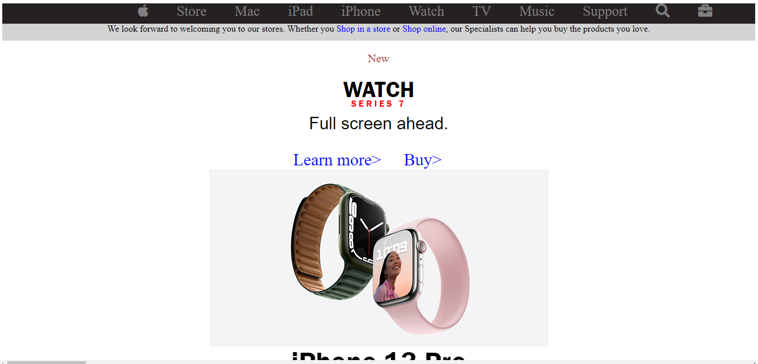
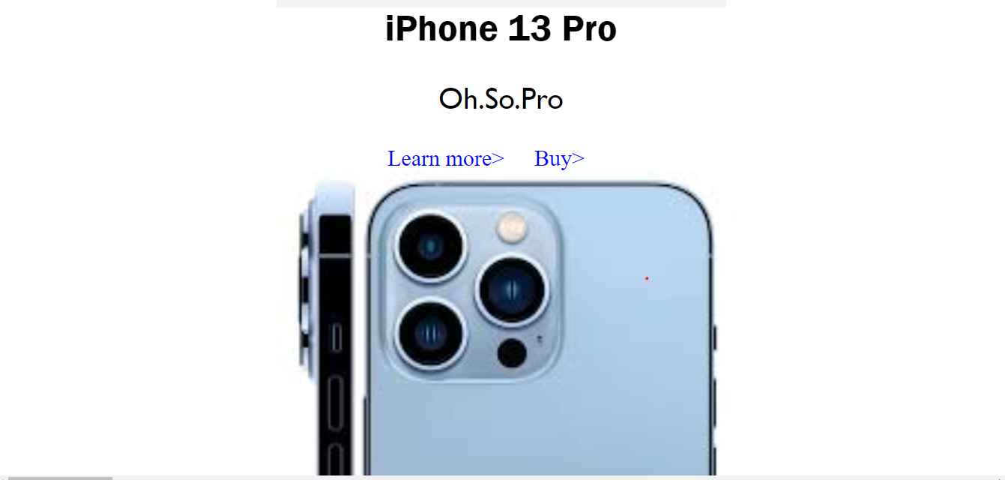
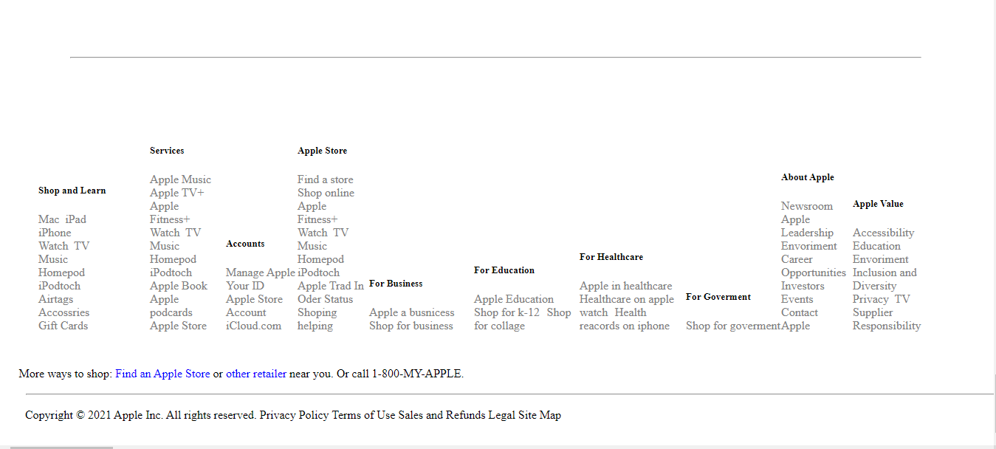
PROJECT OVERVIEW

Slide 6
FEATURE
Simple Design.
Clear Navigation Bar.
High Quality Images.
Modern Style.
Brand and Design Continuity.
Popularity.

Slide 7
MORE FEATURE
YOU CAN PLACE ORDER ONLINE.
YOU CAN GET INFORMATION OF EVERY NEW PRODUCT OF APPLE.
IF YOU SIGIN ON APPLE WEBSITE YOU CAN ALSO PAY YOUR BILL ON INSTALLMENT.
IF YOU ARE MEMBER OF APPLE SO ON EVERY SHOPING OF +50 YOU GET 10$

Slide 8


Slide 9


